Slide 1
Time Series

Slide 2
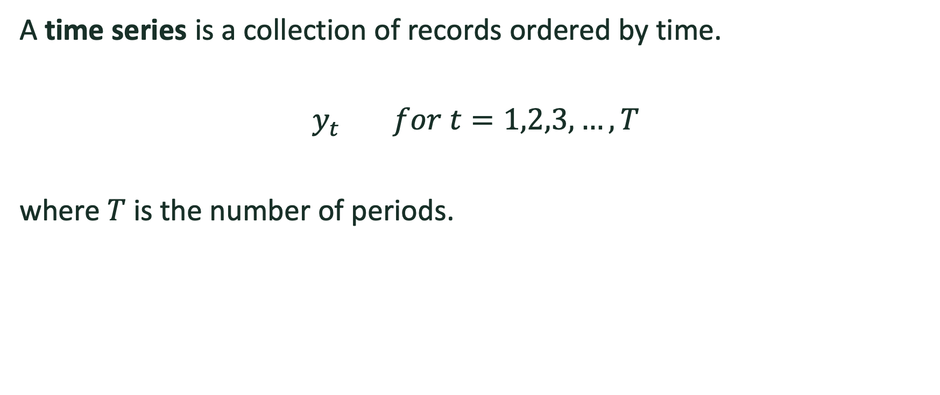
Introduction
A time series is a collection of records ordered by time.
$y_{t}$ $for t=1,2,3,…,T$
where $T$ is the number of periods.

Slide 3
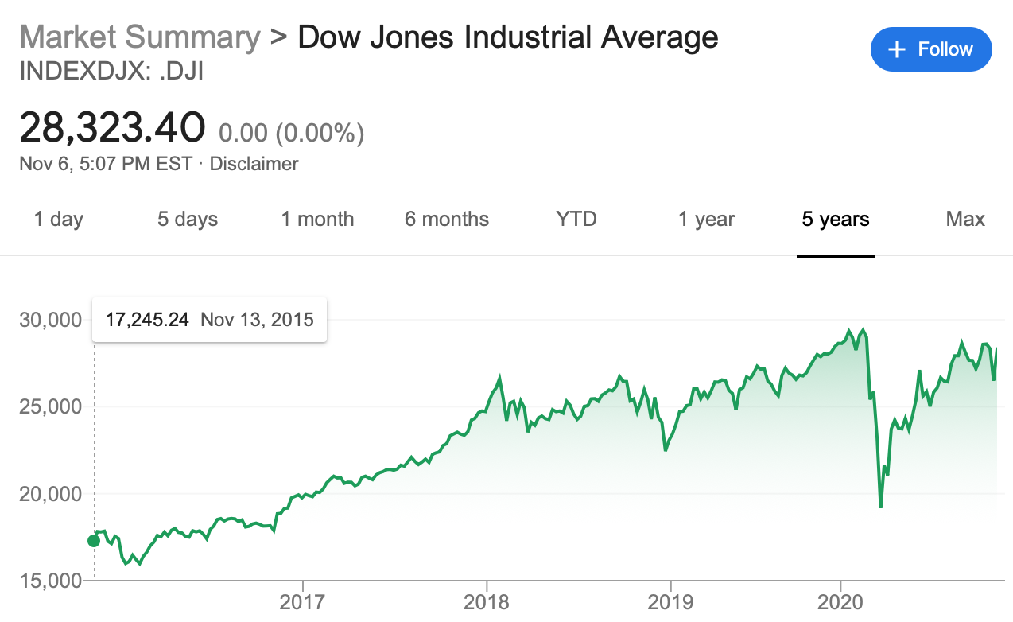
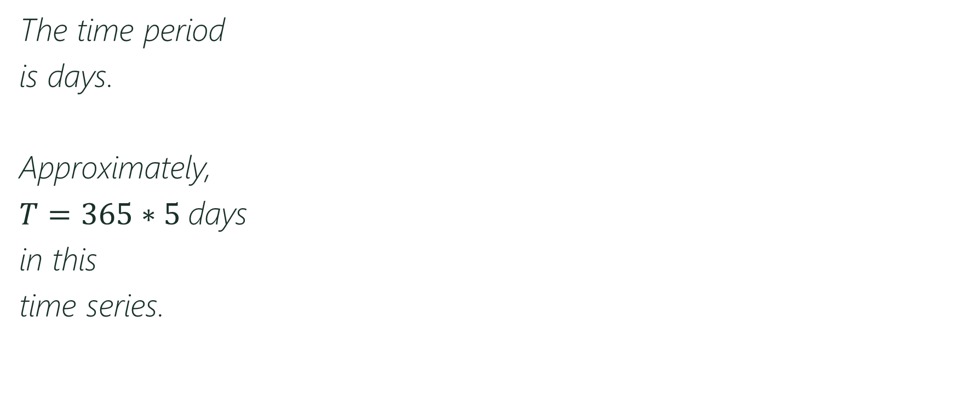
Introduction
The time period
is days.
Approximately,
$T=365∗5$days
in this
time series.

Slide 4
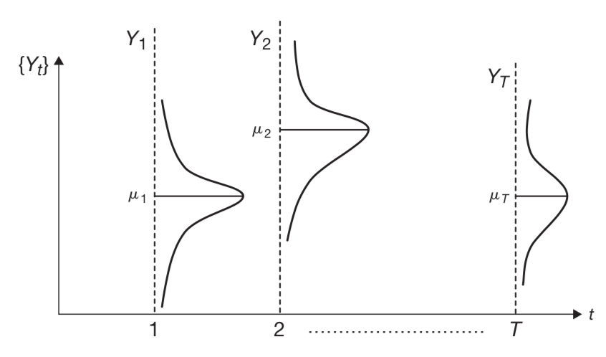
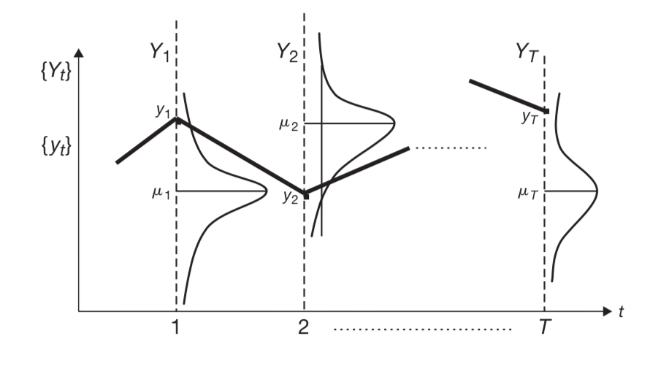
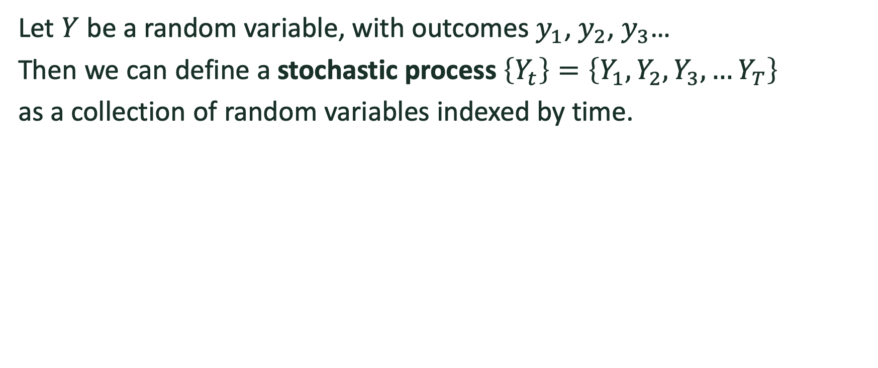
Introduction
Let $Y$ be a random variable, with outcomes $y_{1}$, $y_{2}$, $y_{3}$…
Then we can define a stochastic process $\left\{Y_{t}\right\}=\left\{Y_{1},Y_{2},Y_{3},…Y_{T}\right\}$
as a collection of random variables indexed by time.

Slide 5
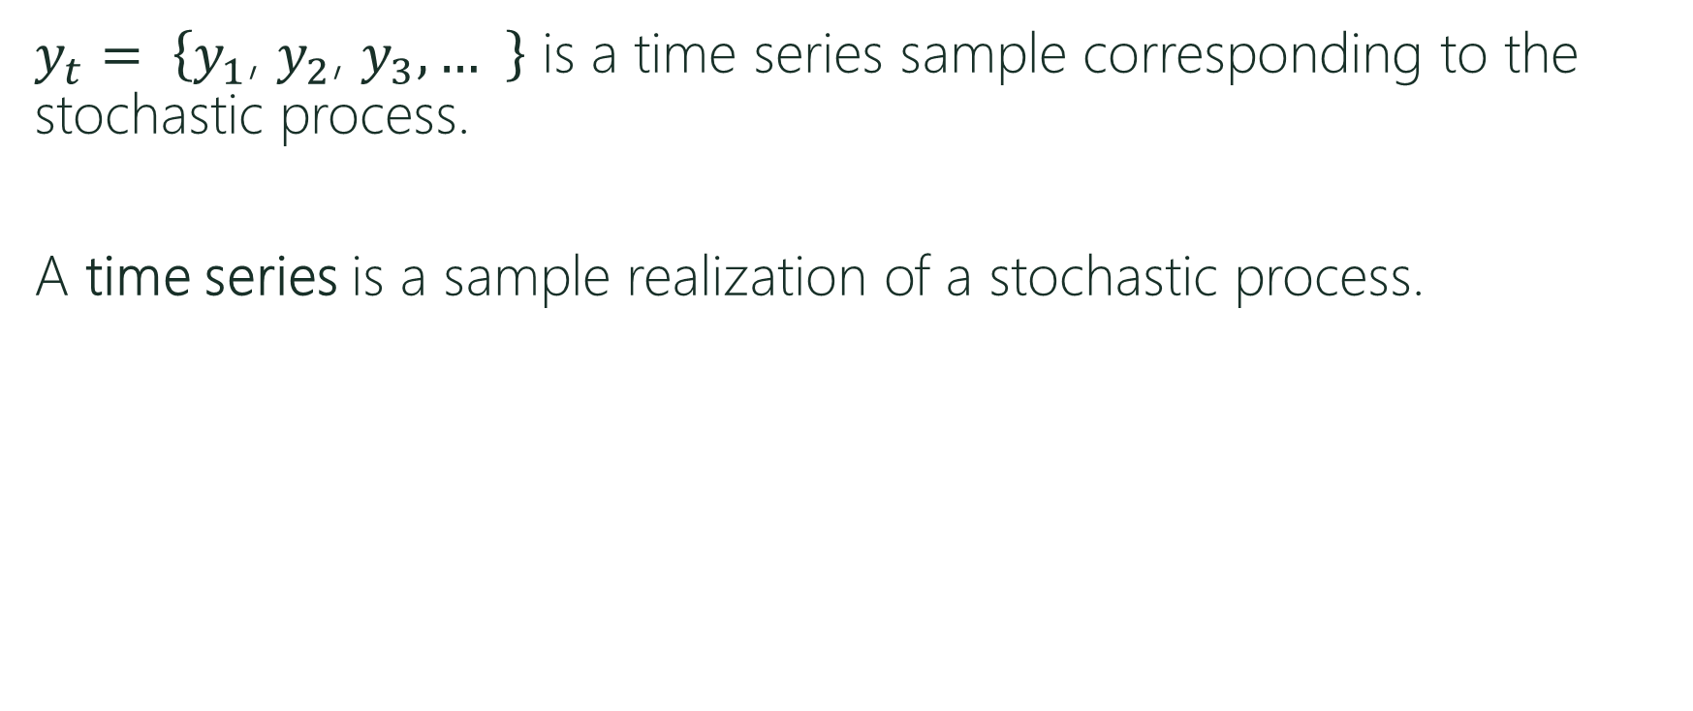
Introduction
$y_{t}= \left\{y_{1}\text{, }y_{2}\text{, }y_{3}, … \right\}$ is a time series sample corresponding to the stochastic process.
A time series is a sample realization of a stochastic process.

Slide 6
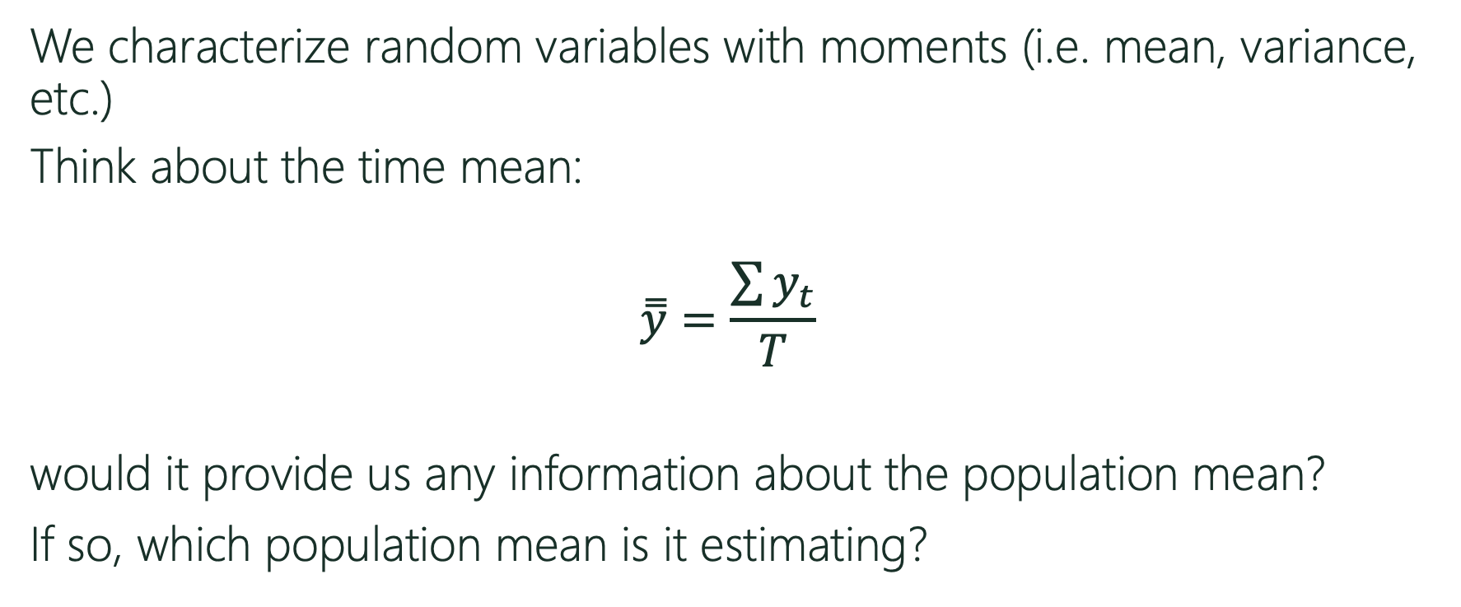
Introduction
We characterize random variables with moments (i.e. mean, variance, etc.)
Think about the time mean:
$$\overset{̿}{y}=\frac{\sum{y_{t}}}{T}$$
would it provide us any information about the population mean?
If so, which population mean is it estimating?

Slide 7
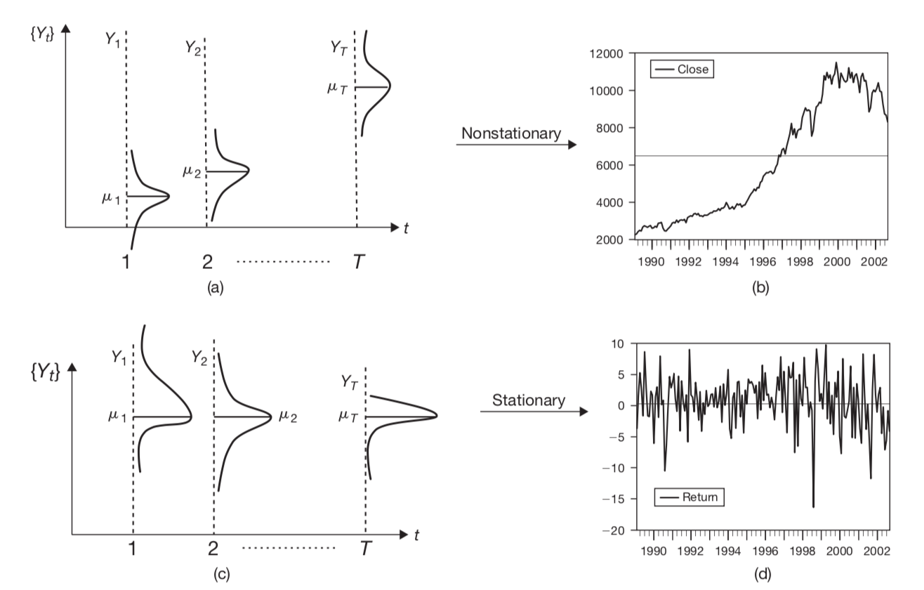
Stationarity
The solid black line
is the time mean of the
series.
Notes:
The mean in the first graph is useless. It is visited once and then never again. In the second series, the value revert or are centered by this mean.

Slide 8
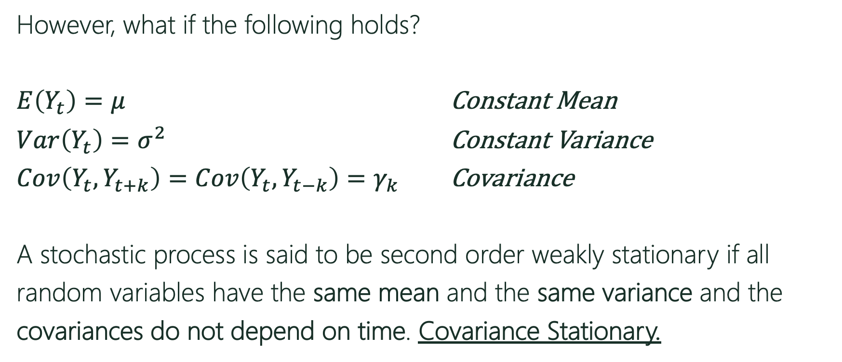
Stationarity
However, what if the following holds?
$E\left(Y_{t}\right)=μ$ Constant Mean
$Var\left(Y_{t}\right)=σ^{2}$ Constant Variance
$Cov\left(Y_{t},Y_{t+k}\right)=Cov\left(Y_{t},Y_{t−k}\right)=γ_{k}$ Covariance
A stochastic process is said to be second order weakly stationary if all
random variables have the same mean and the same variance and the
covariances do not depend on time. Covariance Stationary.
Notes:
We could be very restrictive-> A stochastic process is said to be first order strongly stationary if all
random variables have the same probability density function.
We could be less restrictive->A stochastic process is said to be first order weakly stationary if all
random variables have the same mean.
A stationary time series can be treated as any other random variable, by investigating its mean and variance.

Slide 9
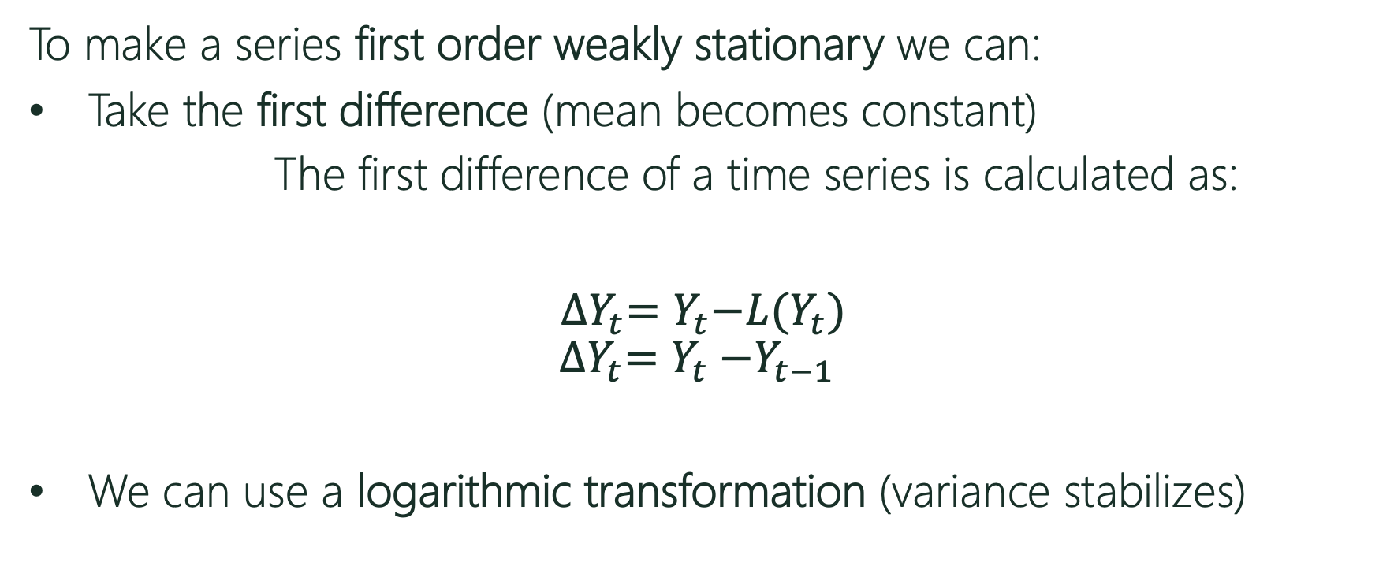
Transformations
To make a series first order weakly stationary we can:
Take the first difference (mean becomes constant)
The first difference of a time series is calculated as:
${∆Y}_{t}=Y_{t}{−L(Y}_{t})$
$${∆Y}_{t}=Y_{t}{−Y}_{t−1}$$
We can use a logarithmic transformation (variance stabilizes)
Notes:
Box Cox Transformation
wt={log(yt)if λ=0;
(yλt−1)/λotherwise.
The BoxCox.lambda() function will choose a value of lambda for you.

Slide 10
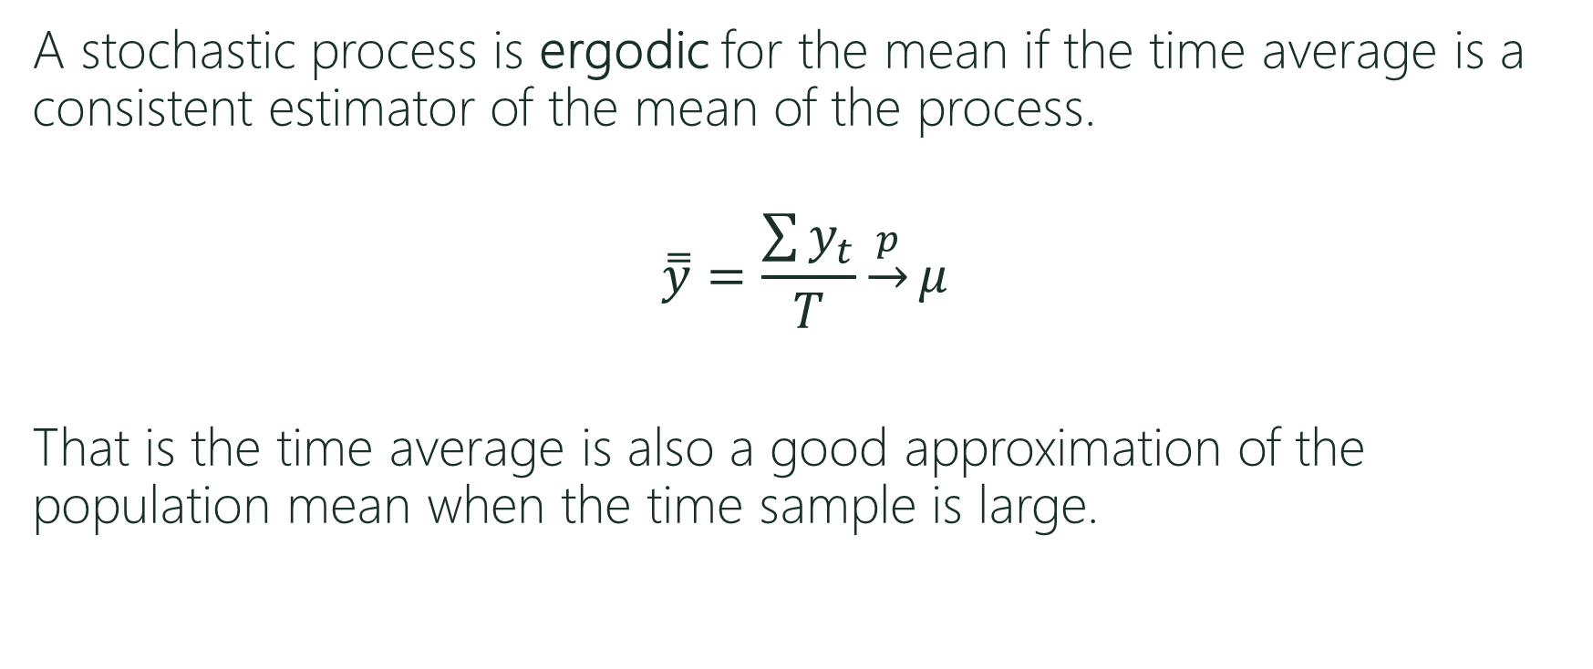
Ergodicity
A stochastic process is ergodic for the mean if the time average is a consistent estimator of the mean of the process.
$$\overset{̿}{y}=\frac{\sum{y_{t}}}{T}\underset{→}{p}μ$$
That is the time average is also a good approximation of the population mean when the time sample is large.

Slide 11
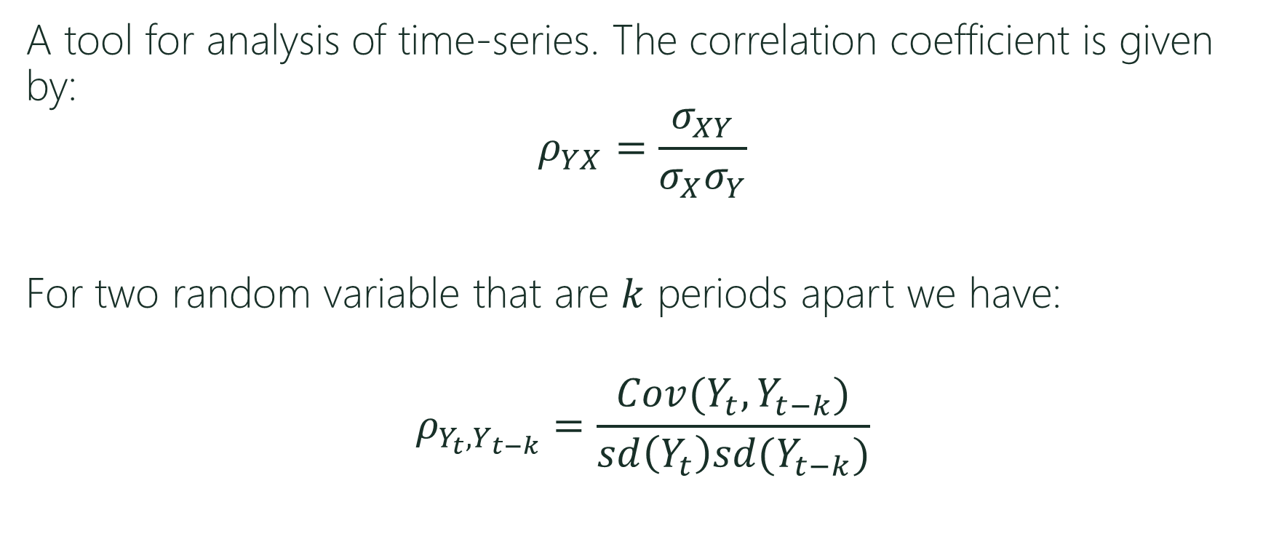
Autocorrelation function (ACF)
A tool for analysis of time-series. The correlation coefficient is given by:
$$ρ_{YX}=\frac{σ_{XY}}{σ_{X}σ_{Y}}$$
For two random variable that are $k$ periods apart we have:
$$ρ_{Y_{t},Y_{t−k}}=\frac{Cov(Y_{t},Y_{t−k})}{sd\left(Y_{t}\right)sd(Y_{t−k})}$$

Slide 12
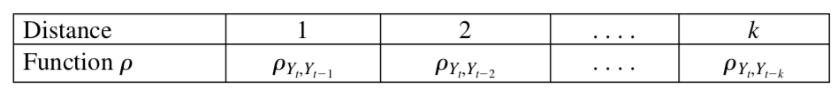
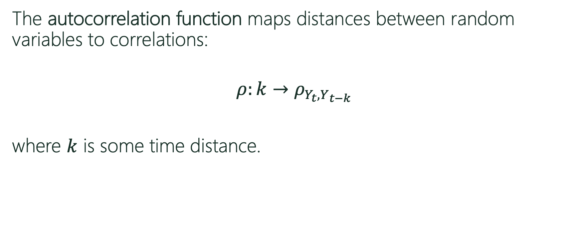
Autocorrelation function (ACF)
The autocorrelation function maps distances between random variables to correlations:
$$ρ:k→ρ_{Y_{t},Y_{t−k}}$$
where $k$ is some time distance.

Slide 13
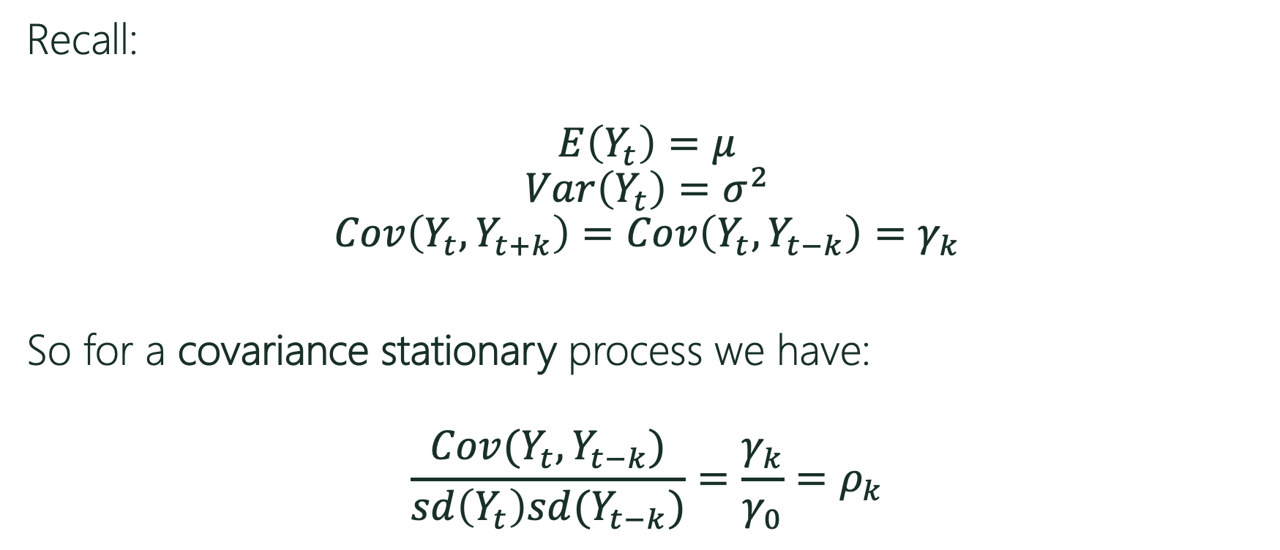
Autocorrelation function (ACF)
Recall:
$$E\left(Y_{t}\right)=μ$$
$$Var\left(Y_{t}\right)=σ^{2}$$
$$Cov\left(Y_{t},Y_{t+k}\right)=Cov\left(Y_{t},Y_{t−k}\right)=γ_{k}$$
So for a covariance stationary process we have:
$$\frac{Cov(Y_{t},Y_{t−k})}{sd\left(Y_{t}\right)sd(Y_{t−k})}=\frac{γ_{k}}{γ_{0}}=ρ_{k}$$
Notes:
Note that sd(Yt)=sigma and sd(Yt-k) is also equal to sigma. The denominator is equal to sigma square (or covariance between yt and yt).

Slide 14
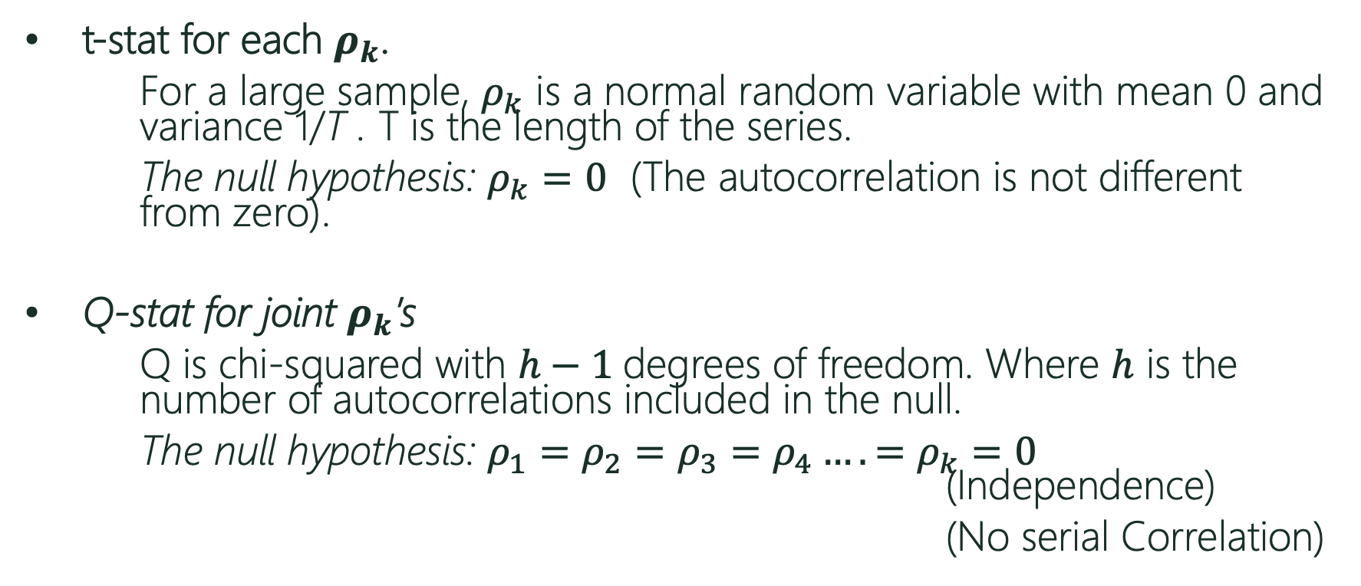
Significance (t-stat and Ljung-Box)
t-stat for each $ρ_{k}$.
For a large sample, $ρ_{k}$ is a normal random variable with mean 0 and variance 1/T . T is the length of the series.
The null hypothesis: $ρ_{k}=0$ (The autocorrelation is not different from zero).
Q-stat for joint $ρ_{k}$’s
Q is chi-squared with $h−1$degrees of freedom. Where $h$ is the number of autocorrelations included in the null.
The null hypothesis: ${ρ_{1}=ρ_{2}=ρ_{3}=ρ_{4}….=ρ}_{k}=0$ (Independence)
(No serial Correlation)

Slide 15
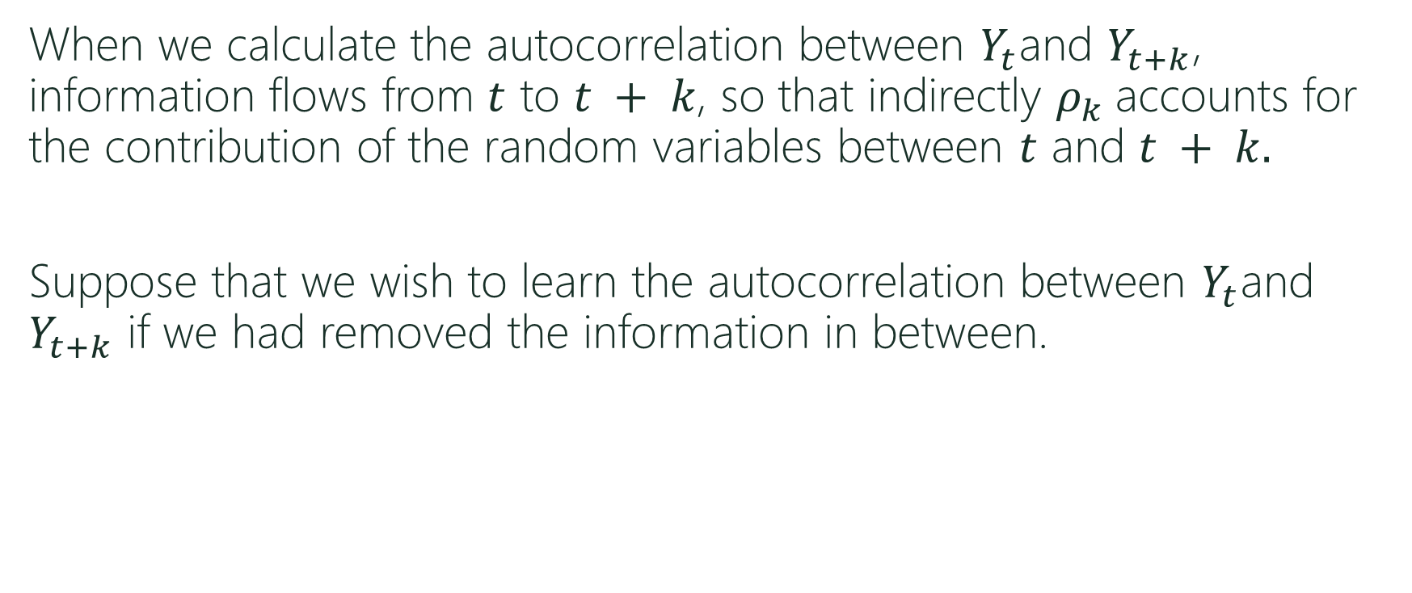
Partial Autocorrelation function (PACF)
When we calculate the autocorrelation between $Y_{t}$and $Y_{t+k}$, information flows from $t$ to $t + k$, so that indirectly $ρ_{k}$accounts for the contribution of the random variables between $t$ and $t + k.$
Suppose that we wish to learn the autocorrelation between $Y_{t}$and $Y_{t+k}$ if we had removed the information in between.

Slide 16
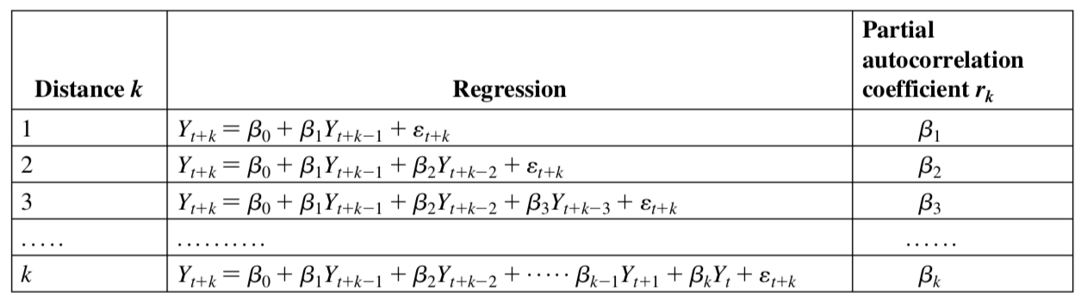
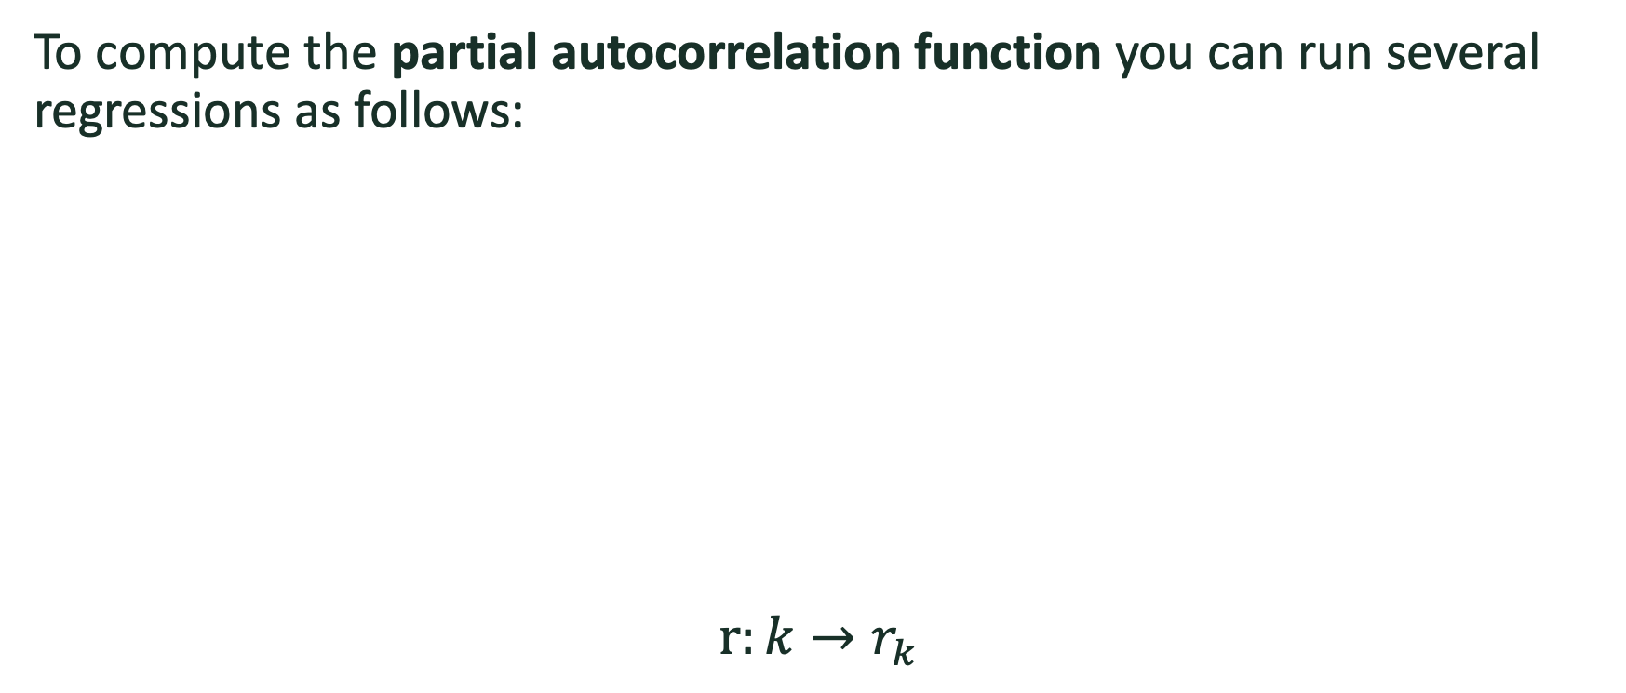
Partial Autocorrelation function (ACF)
To compute the partial autocorrelation function you can run several regressions as follows:
$$r:k→r_{k }$$

Slide 17
Test You Understanding
In R:
Load the DJdata set.
Plot the data. Is the data stationary?
Use the diff() function to difference your data. Now plot the first difference. Does the mean look constant? Does the variance look constant?
Use a logarithmic transformation. Did the variance stabilize?

Slide 18
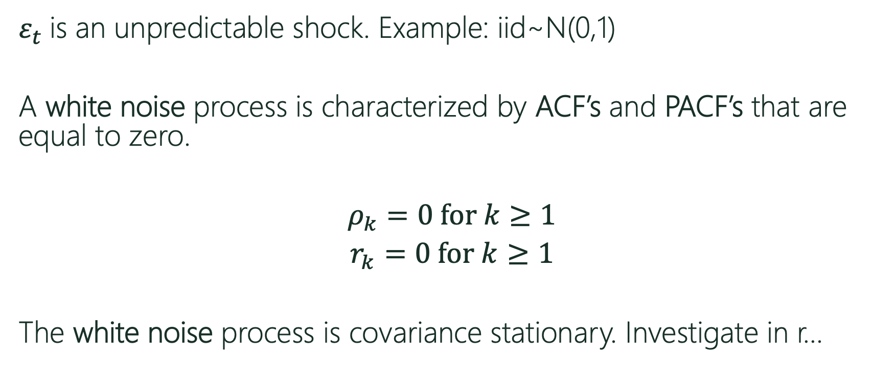
White Noise Process
$ε_{t}$ is an unpredictable shock. Example: iid~N(0,1)
A white noise process is characterized by ACF’s and PACF’s that are equal to zero.
$ρ_{k}=0$ for $k≥1$
$r_{k}=0$ for $k≥1$
The white noise process is covariance stationary. Investigate in r…
Notes:
Observe in R

Slide 19
Test Your Understanding
In R:
Download and Load the “forecast” package.
Calculate the ACF for the stationary DJ data. Are there any statistically significant lags?
Calculate the PACF for the stationary DJ data. Are there any statistically significant lags? Can you calculate the same numbers using regression? (hint: use the “dynlm” package)
Repeat for the working hours data sets, Germany and USA.

Slide 20
The Cob-Web Model
Time Dependence

Slide 21
The Cob-Web Model
Prices are determined by
the forces of supply and
demand.
The market is affected by
unpredictable supply shocks.
Suppliers expect tomorrow’s
price to be today’s price.
Notes:
$ε$

Slide 22
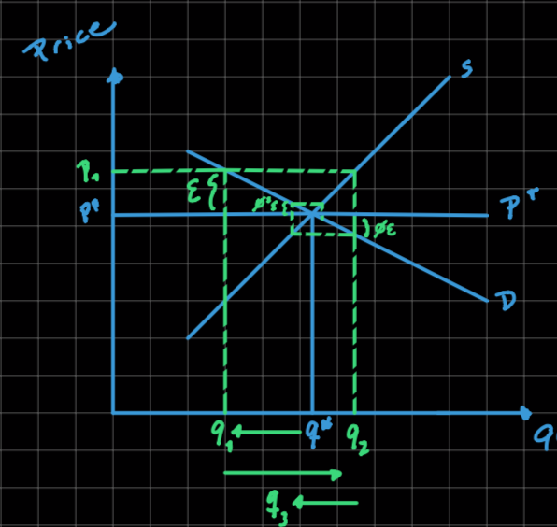
The Cob-Web Model
Consider a supply shock in the market for oranges. Bad weather affects production of oranges.
Producers reduce production.
Prices increase.
Producers keep adjusting production
given the new prices.
The weather shock affects
the market for several periods.
The market gravitates back to
equilibrium.

Slide 23
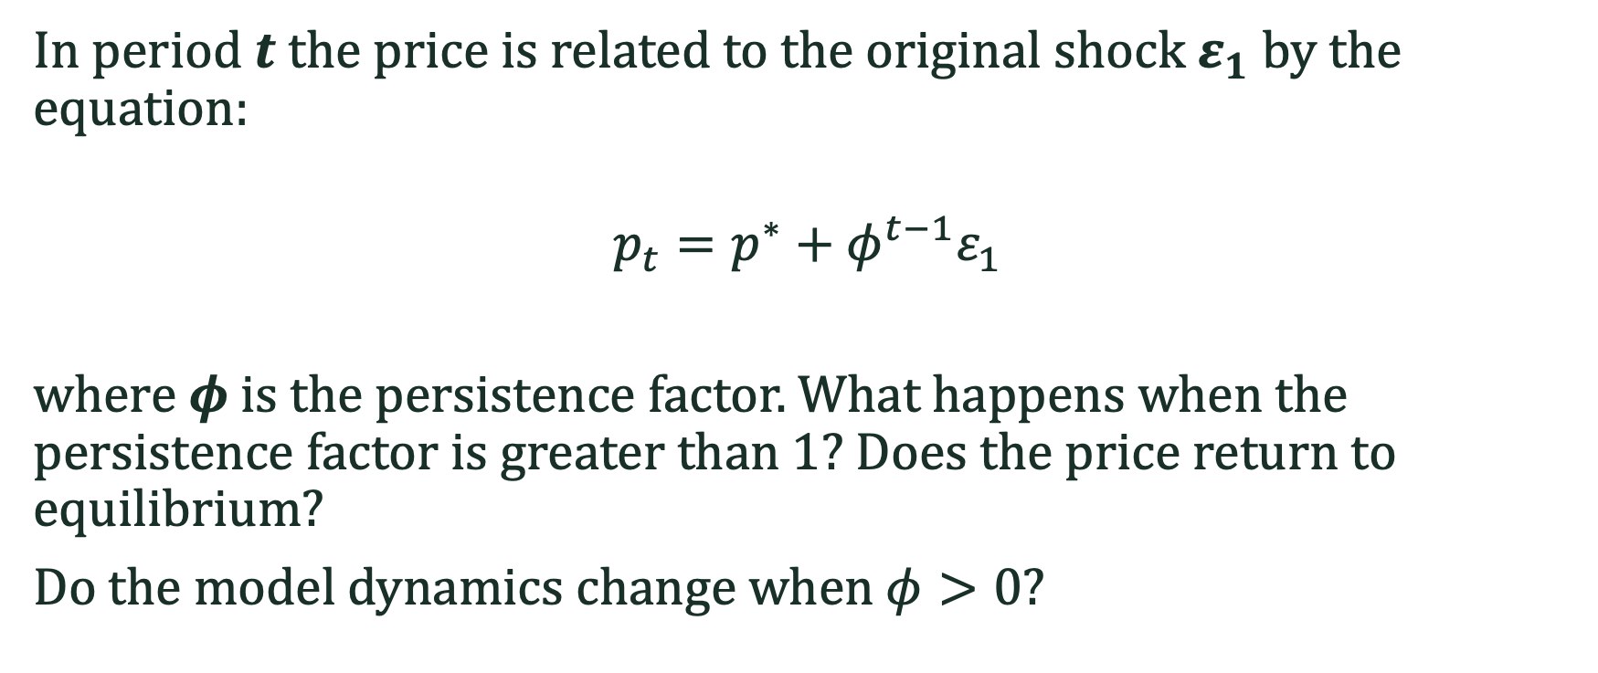
Cob-Web Model
In period $t$the price is related to the original shock $ε_{1}$ by the equation:
$$p_{t}=p^{∗}+φ^{t−1}ε_{1}$$
where $φ$ is the persistence factor. What happens when the persistence factor is greater than 1? Does the price return to equilibrium?
Do the model dynamics change when $φ>0$?

Slide 24
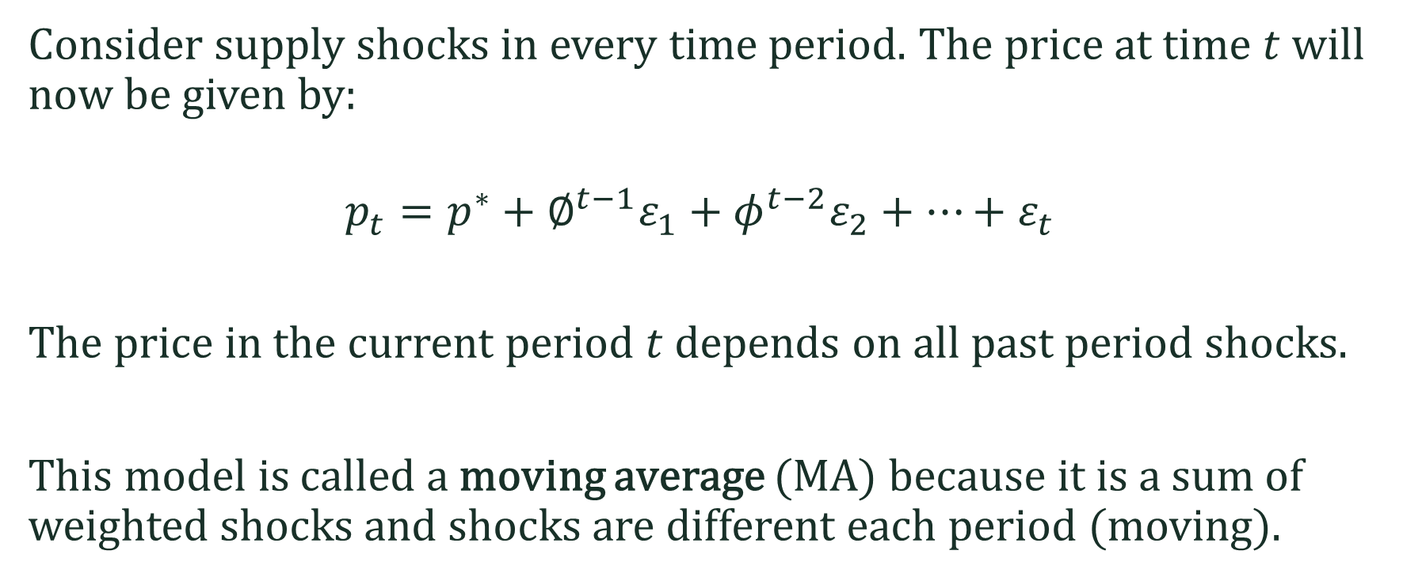
Moving Average Process (MA)
Consider supply shocks in every time period. The price at time $t$ will now be given by:
$$p_{t}=p^{∗}+∅^{t−1}ε_{1}+φ^{t−2}ε_{2}+…+ε_{t}$$
The price in the current period $t$depends on all past period shocks.
This model is called a moving average (MA) because it is a sum of weighted shocks and shocks are different each period (moving).

Slide 25
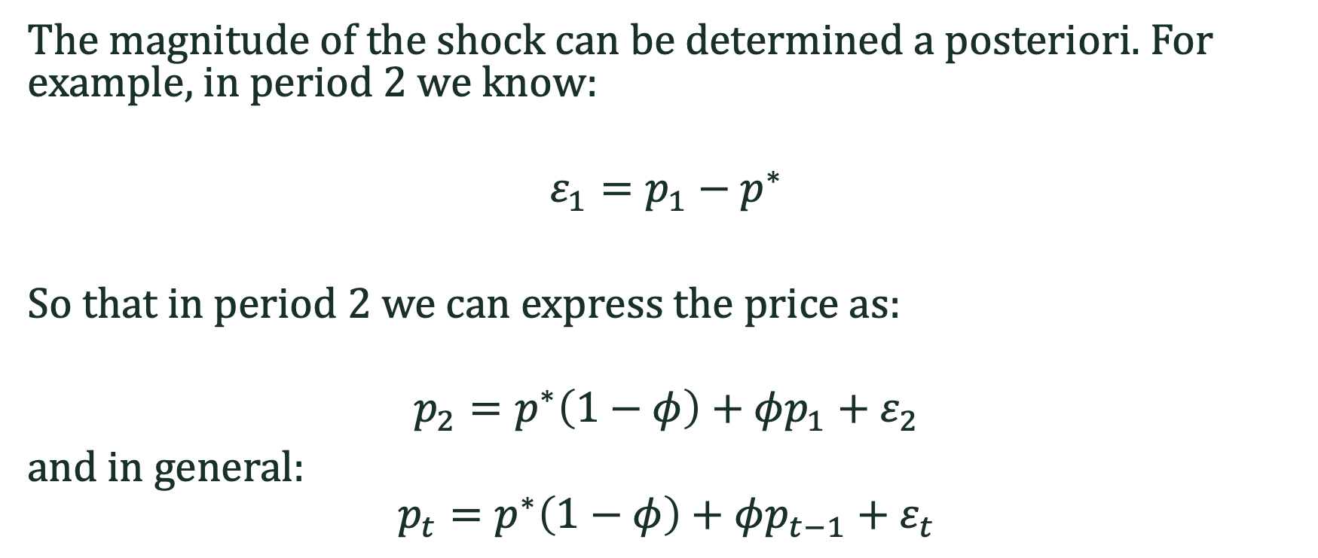
Autoregressive Process (AR)
The magnitude of the shock can be determined a posteriori. For example, in period 2 we know:
$$ε_{1}=p_{1}−p^{∗}$$
So that in period 2 we can express the price as:
$$p_{2}=p^{∗}\left(1−φ\right)+φp_{1}+ε_{2}$$
and in general:
$$p_{t}=p^{∗}\left(1−φ\right)+φp_{t−1}+ε_{t}$$

Slide 26
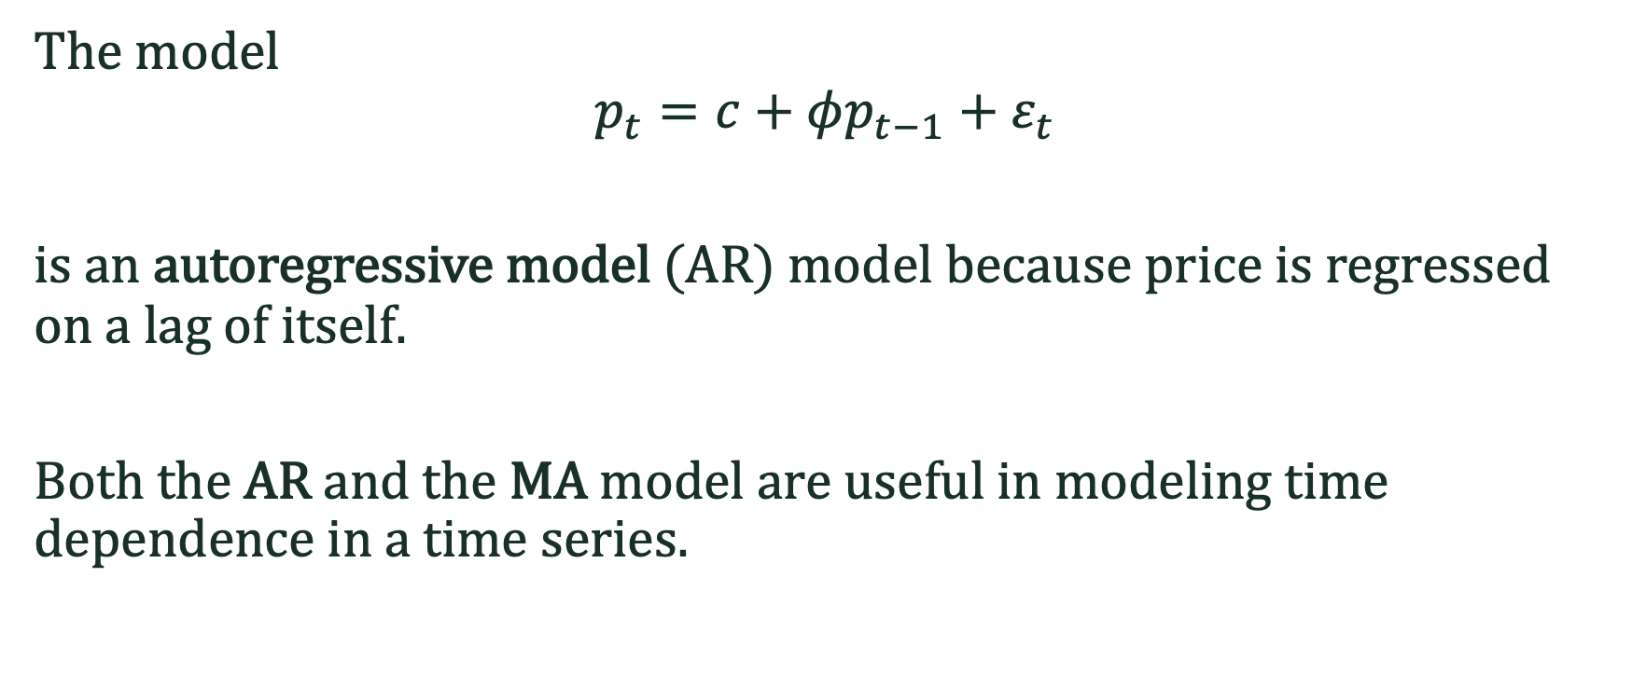
Autoregressive Process (AR)
The model
$$p_{t}=c+φp_{t−1}+ε_{t}$$
is an autoregressive model (AR) model because price is regressed on a lag of itself.
Both the AR and the MA model are useful in modeling time dependence in a time series.
Notes:
Price itself carries information of prior period

Slide 27
The Moving Average Process

Slide 28
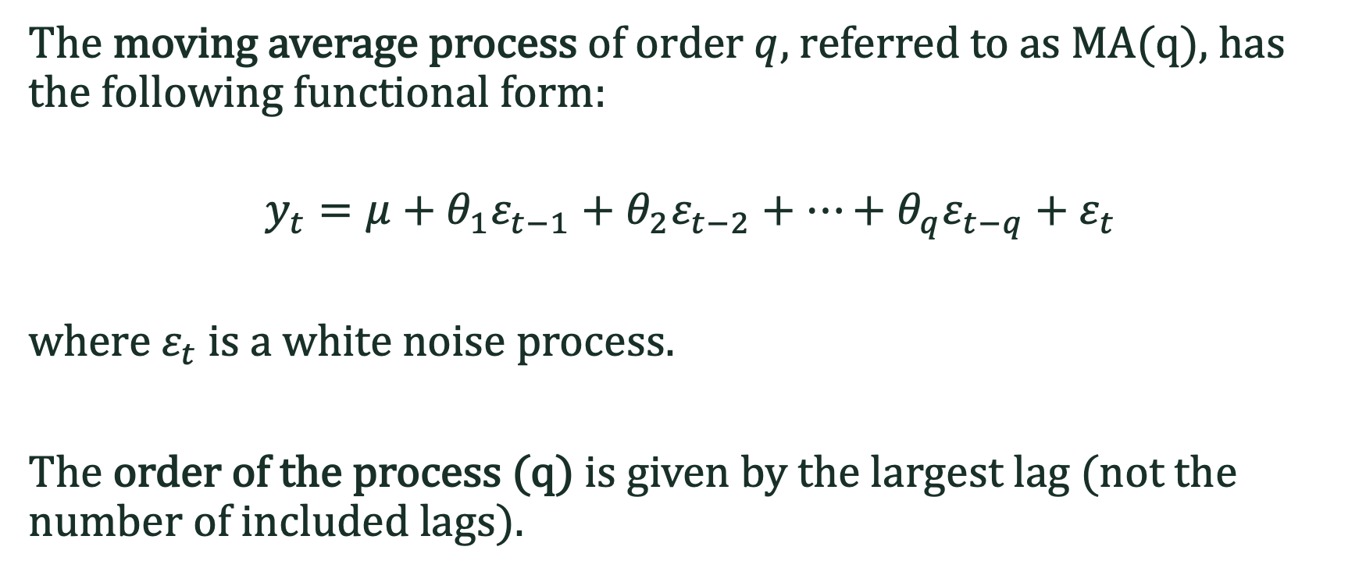
MA(q)
The moving average process of order $q$, referred to as MA(q), has the following functional form:
$$y_{t}=μ+θ_{1}ε_{t−1}+θ_{2}ε_{t−2}+…+θ_{q}ε_{t−q}+ε_{t}$$
where $ε_{t}$ is a white noise process.
The order of the process (q) is given by the largest lag (not the number of included lags).

Slide 29
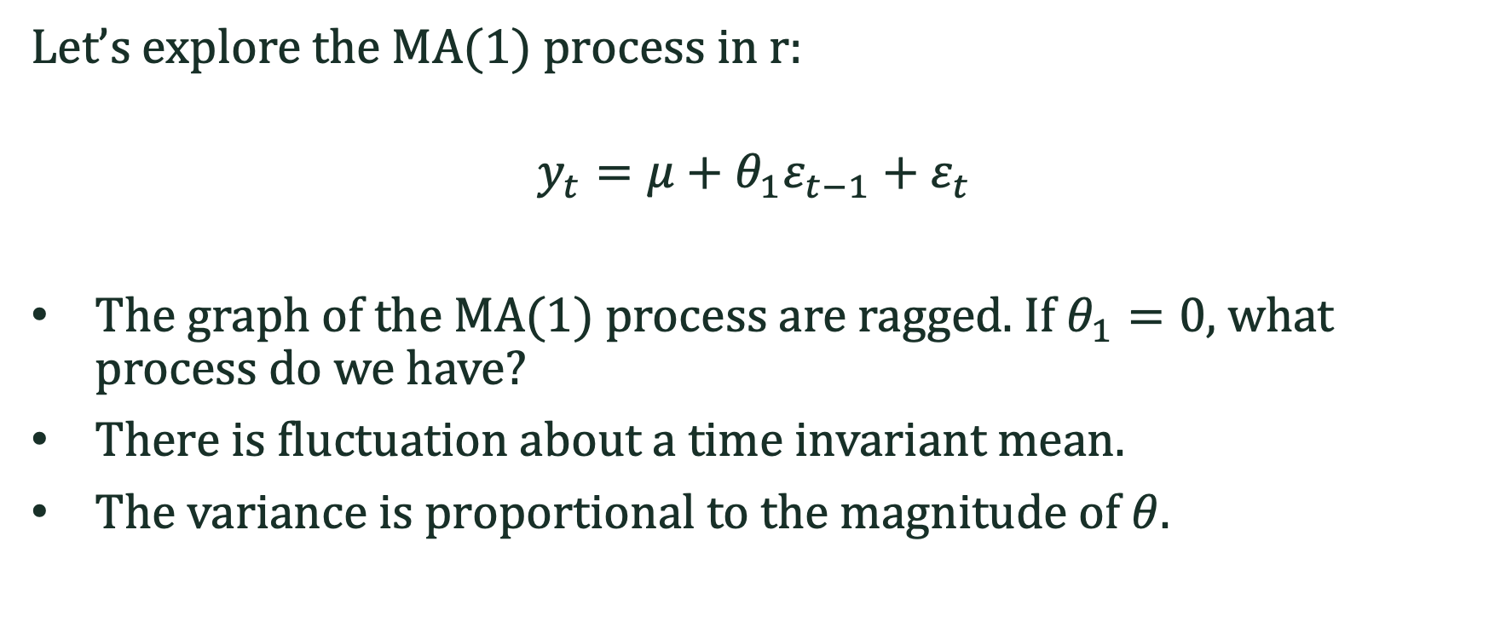
MA(1)
Let’s explore the MA(1) process in r:
$$y_{t}=μ+θ_{1}ε_{t−1}+ε_{t}$$
The graph of the MA(1) process are ragged. If $θ_{1}=0$, what process do we have?
There is fluctuation about a time invariant mean.
The variance is proportional to the magnitude of $θ$.

Slide 30
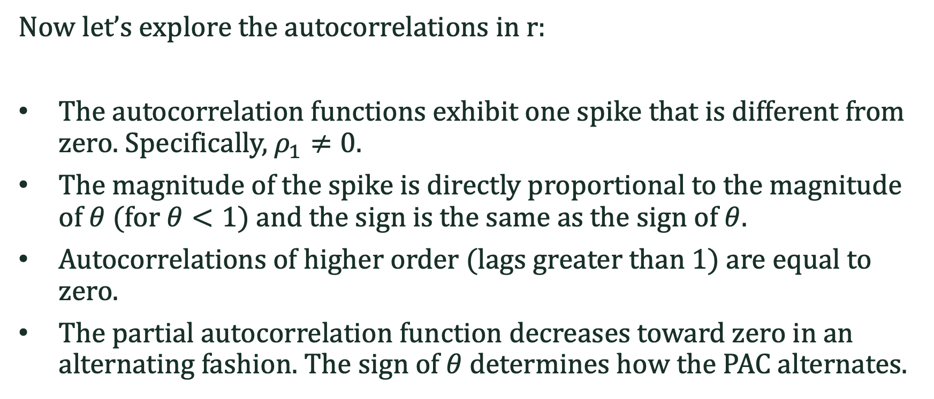
MA(1)
Now let’s explore the autocorrelations in r:
The autocorrelation functions exhibit one spike that is different from zero. Specifically, $ρ_{1}≠0.$
The magnitude of the spike is directly proportional to the magnitude of $θ$ (for $θ<1$) and the sign is the same as the sign of $θ$.
Autocorrelations of higher order (lags greater than 1) are equal to zero.
The partial autocorrelation function decreases toward zero in an alternating fashion. The sign of $θ$ determines how the PAC alternates.

Slide 31
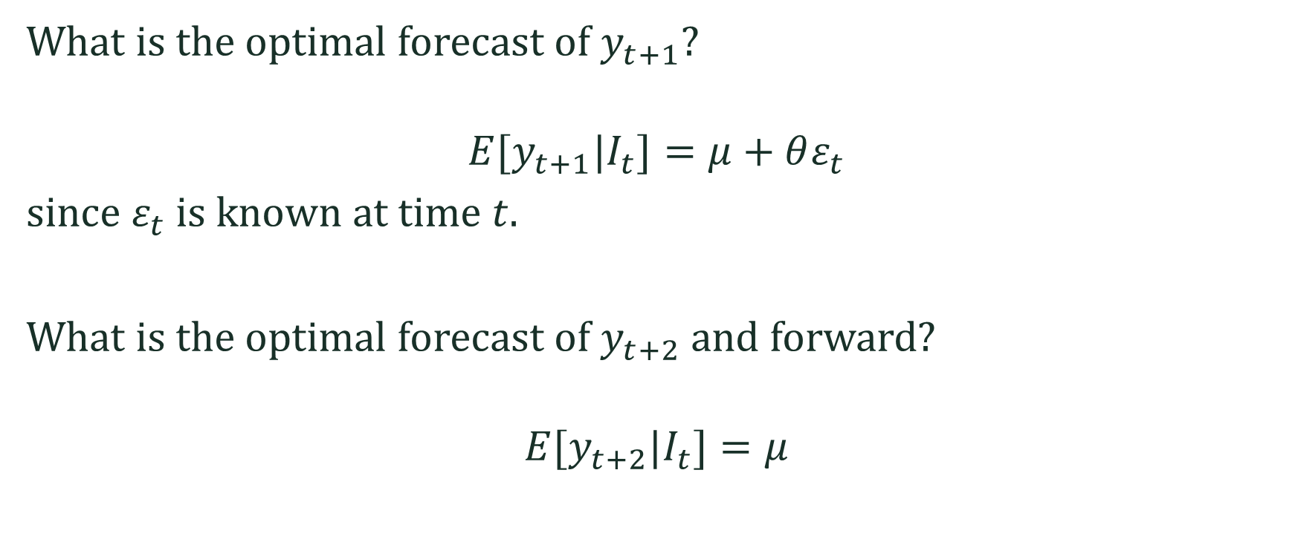
Forecast
What is the optimal forecast of $y_{t+1}$?
$${E[y}_{t+1}|I_{t}]=μ+θε_{t}$$
since $ε_{t}$ is known at time $t$.
What is the optimal forecast of $y_{t+2}$ and forward?
$${E[y}_{t+2}|I_{t}]=μ$$

Slide 32
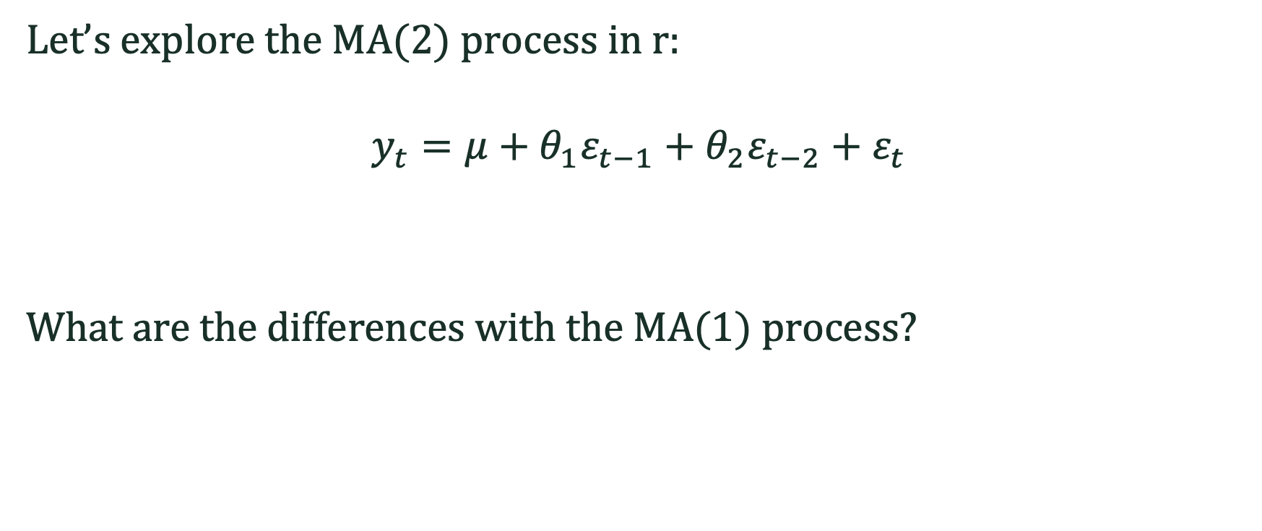
MA(2)
Let’s explore the MA(2) process in r:
$$y_{t}=μ+θ_{1}ε_{t−1}+θ_{2}ε_{t−2}+ε_{t}$$
What are the differences with the MA(1) process?

Slide 33
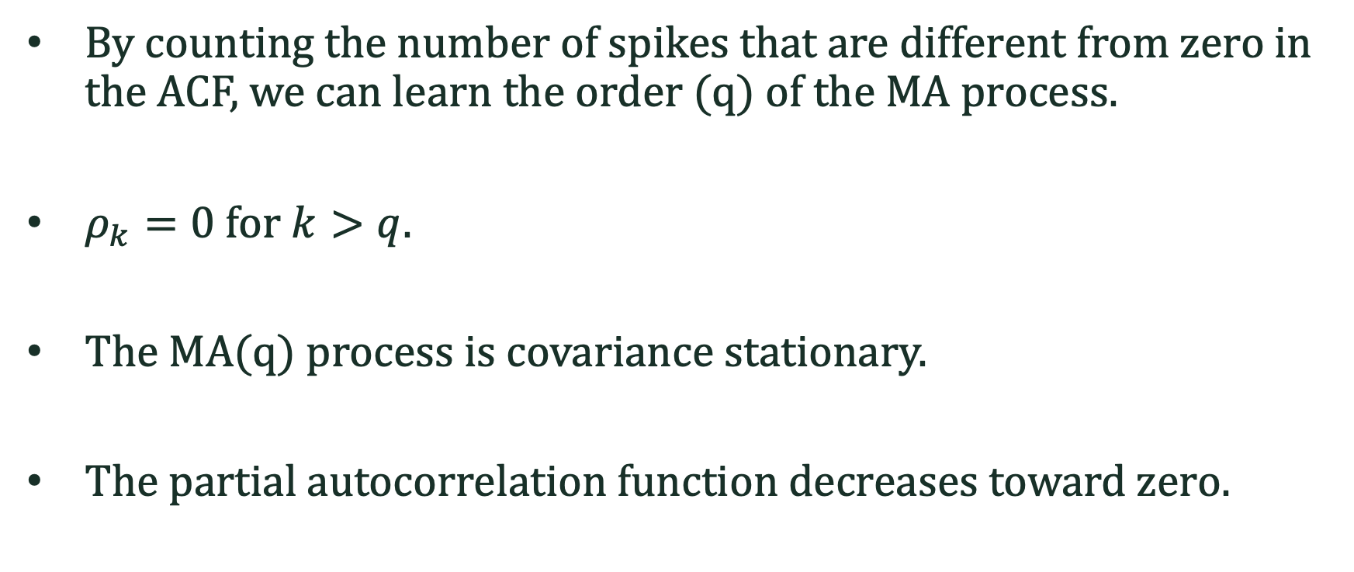
MA(q)
By counting the number of spikes that are different from zero in the ACF, we can learn the order (q) of the MA process.
$ρ_{k}=0$ for $k>q$.
The MA(q) process is covariance stationary.
The partial autocorrelation function decreases toward zero.

